Slide 1
TrainUP
Online Meeting
Lesson 01 – Simple Present

Slide 2
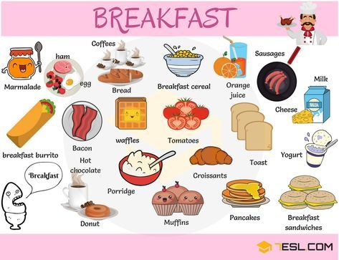
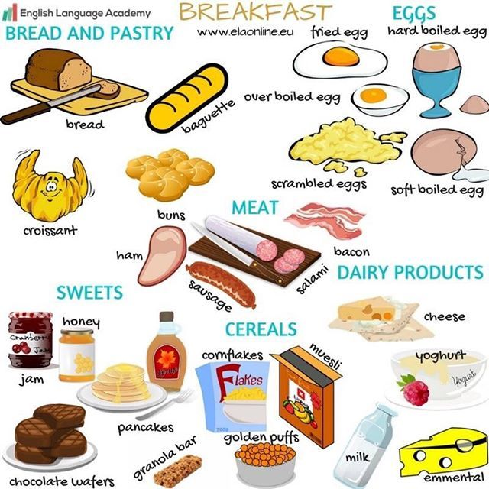

breakfast

Slide 3

movies

Slide 4
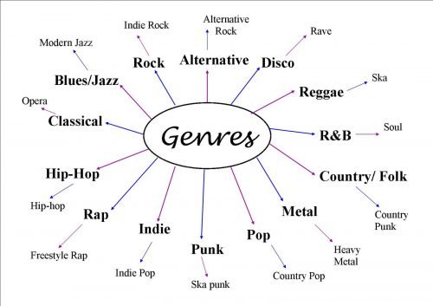
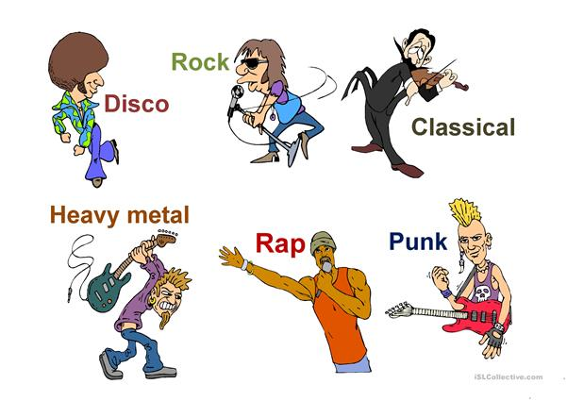
music

Slide 5


Books & Magazines

Slide 6
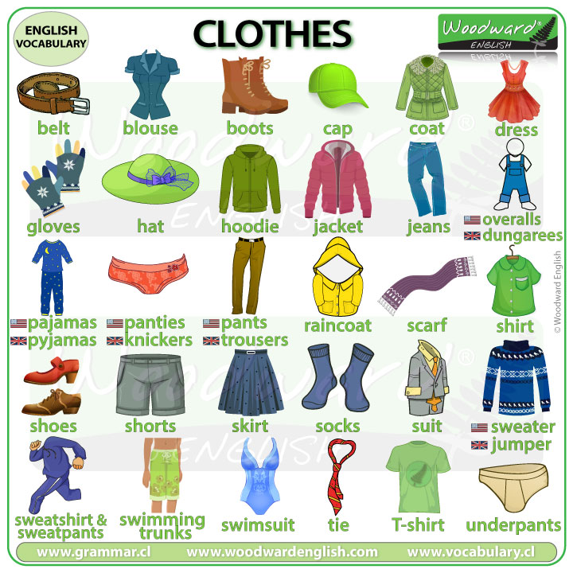
clothes

Slide 7


TrainUP
Online Meeting
Lesson 01 – Simple Present

